Slide 1
Homecredit Data analysis
By Wildan . Datascientist candidate

Slide 2
Background
The data is provided by Home Credit, a service dedicated to provided lines of credit (loans) to the unbanked population. On 2019 , Homecredit already has 29 million costumer across 14 countries
The Main focus on this presentation is to show what the data is allabout and to suggest which Machine learning model is the best to use for credit analytics
Note: This presentation only show the graph and analytics. The full code is on notebook provided

Slide 3
Brief summary of data representation
Heres a brief summary of each datasets:
1.aplication: The main data that split into 2 parts, the train that has target and test that doesn’t have
2.bureau: Data concerning client's previous credits from other financial institutions. Each previous credit has its own row in bureau, but one loan in the application data can have multiple previous credits.
3.bureau balance : Status and balance for each client monthly in bureau
4.credit_card_balance: monthly data about previous credit cards clients have had with Home Credit. Each row is one month of a credit card balance, and a single credit card can have many rows.
5.POS_CASH_balance: history from pointofsales in homecredit
6.previous_application: history from previous application in homecredit
7.installments_payments : history previous payment in homecredit

Slide 4
The analysis
Split into 3 part:
Part 1 : Exploratory data analysis , to know the distribution of the data, to gain information from the data
Part 2 : Feature importance using LGBM
Part 3 : Machine learning model for credit loan

Slide 5
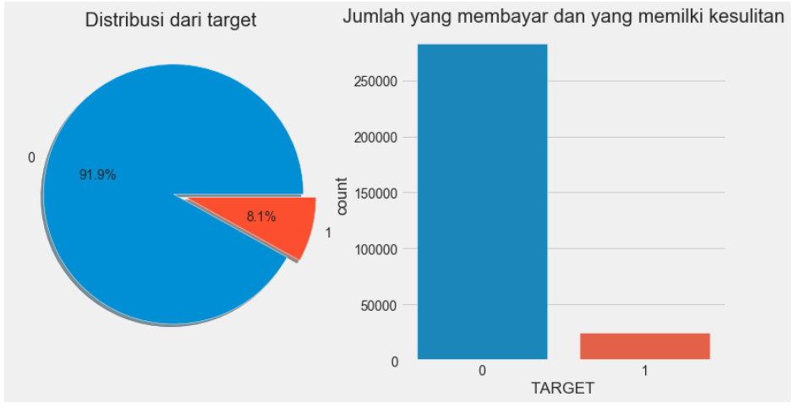
1st part Explarotory Data Analysis(EDA)
EDA is to explore and to explain the data in interactive way possible so we could utilize and extract the data
The Graph Shown on the left is about the amount of client that is capable of paying back the loan which is around 91.1%(Target 0 ) and 8.1% of the population having a hard times or difficulties for paying back

Slide 6
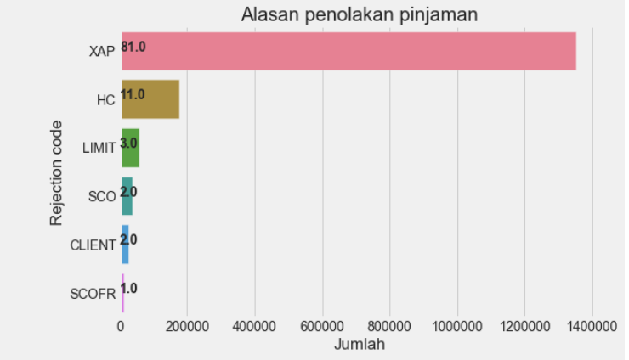
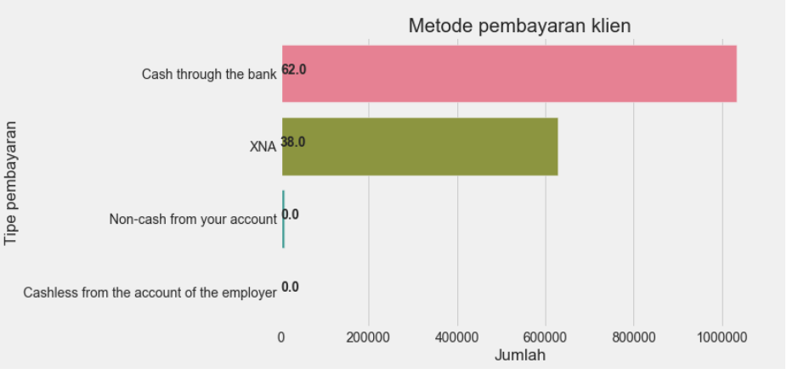
Data is from previous application dataset . It represent the most commont rejection and its amount .From this point we can say the most is from XAP code, HC and limit
The graph shown on left is the metode that is the most commonly used for payment loan

Slide 7
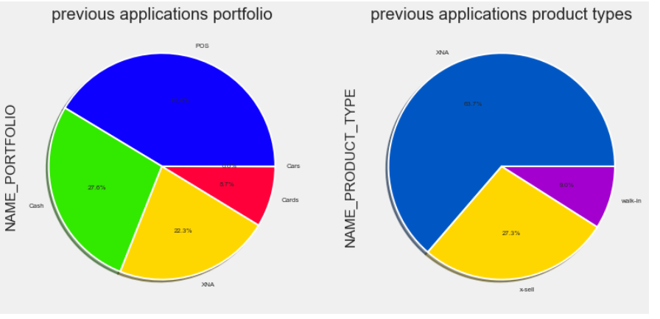
Previous applications portfolio and product types EDA
NAME_PORTFOLIO - Was the previous application for CASH, POS, CAR, … NAME_PRODUCT_TYPE - Was the previous application x-sell o walk-in.

Slide 8
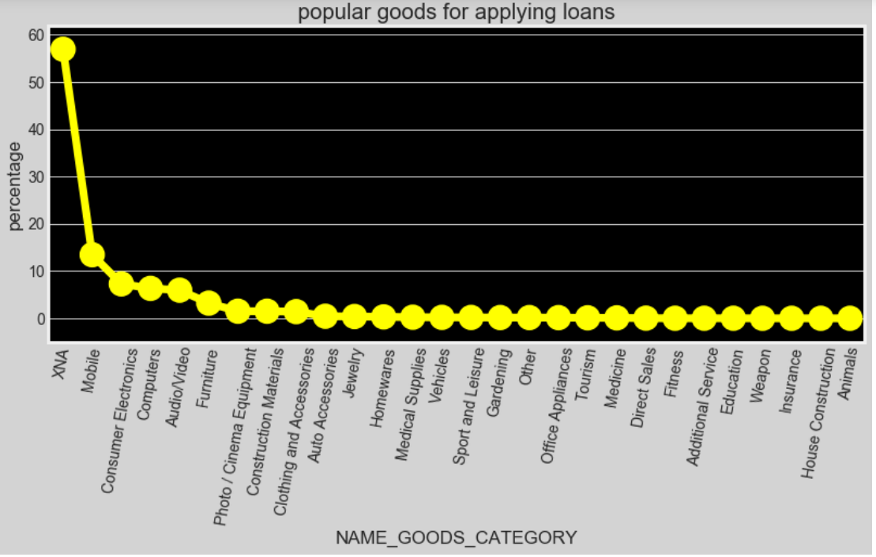
The Graph above is representation of the most popular goods for loan . Top products are mobile, computer , video , furniture

Slide 9
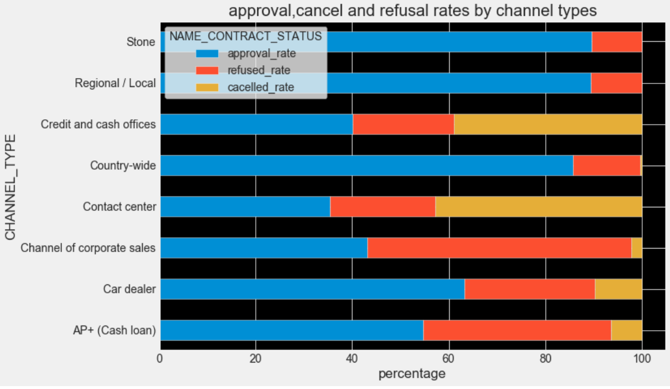
The graph above representating the channel of each client from previous application and how much the approval rating(contract status) for each channel . In the data above we could see the channel from Stone and regional/local has the smallest refused rate with the highest approval rate.The channel of corporate sales has the worst struggle here with the most refused_rate

Slide 10
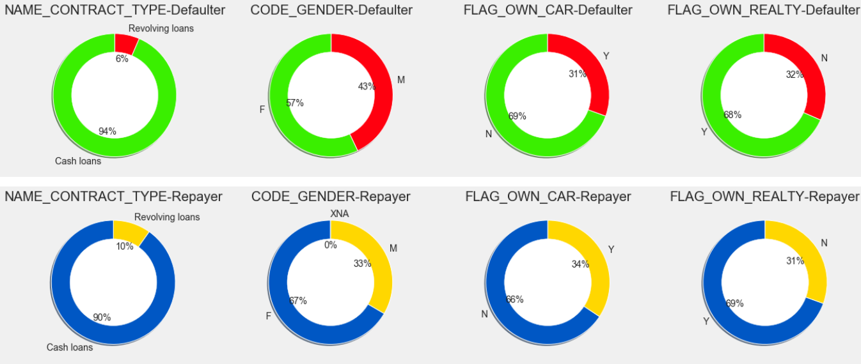
Divided into 2 parts, the first parts is the graph showing with difficulties of payment (target =1) , the second parts is the one with no difficulties(target = 0) all parts showing the distribution based on payment type, gender, car owner, Realty owner

Slide 11
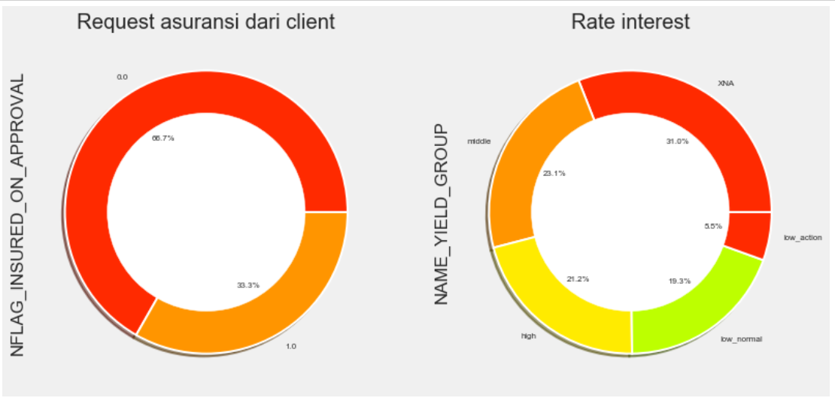
Piechart1 represent is the applicant requesting insurance or not
Piechart2 represent the interest that is leveled by high,low or medium rate

Slide 12
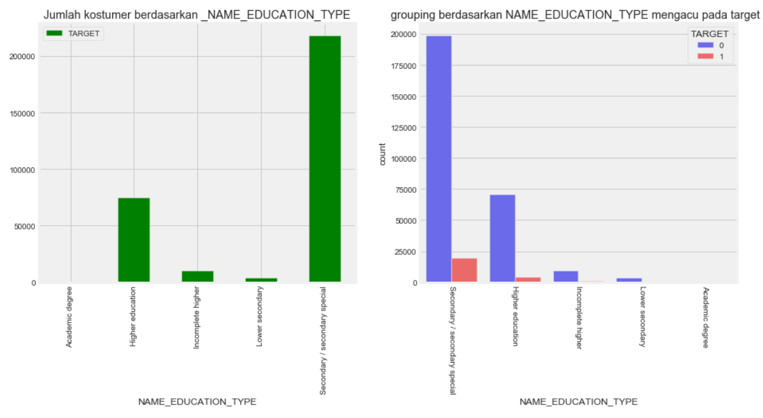
Grouped by the level of education. Most client is on secondary/special level, the second higher is on higher education level. Most difficulties applied on second/secondary special level to payback the loan

Slide 13
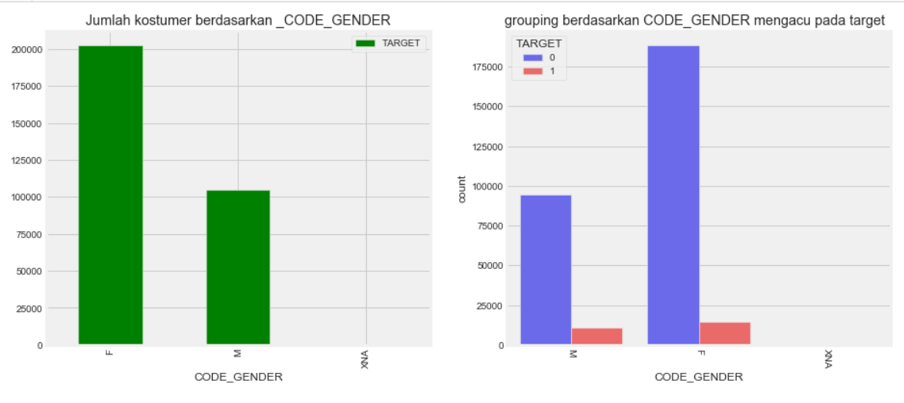
Grouped by gender. The most costumer is female. Based on ratio male applicant has the highest difficulties of paying back the loan even the female applicant is the most

Slide 14
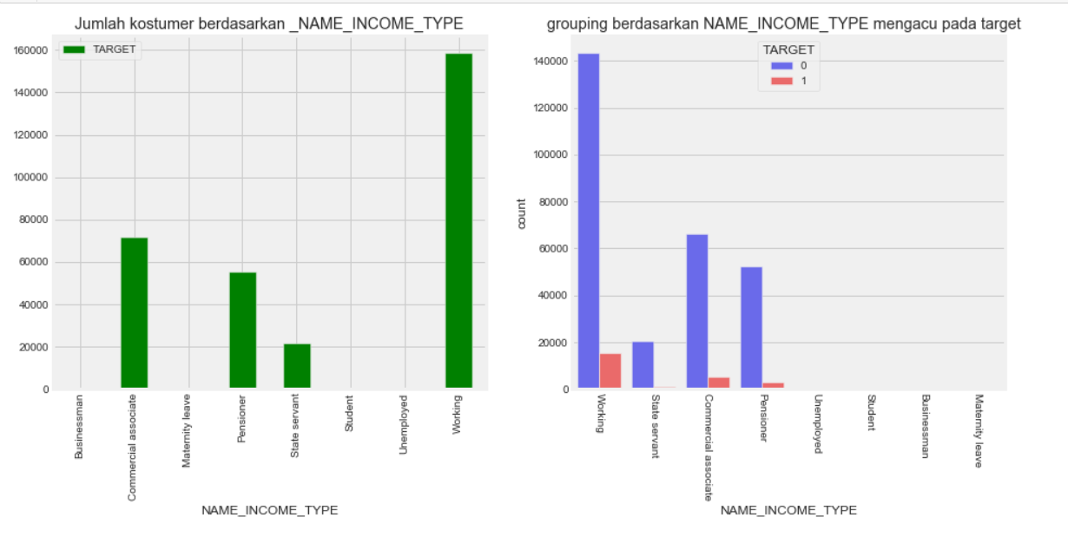
Grouping by income Type. The most applicant is from working group. And the least is from sales servant. Working group also has the most difficulties on paying back the loan

Slide 15
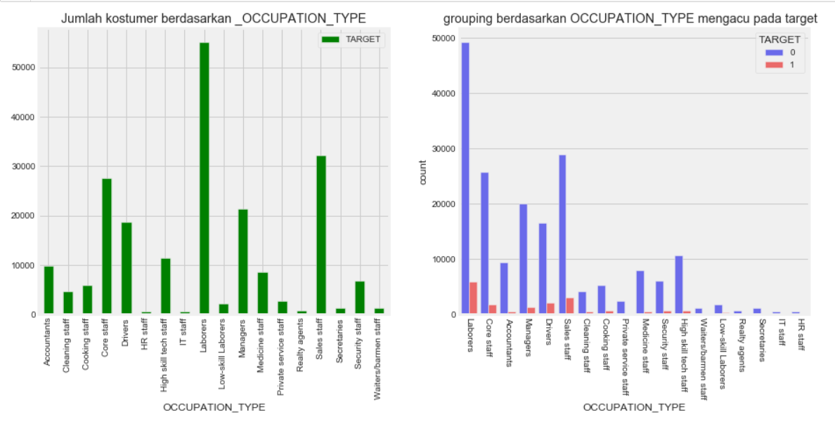
The most applicant is from labrorers and also has the most difficulties on paying back . The scond highest is from sales staff group

Slide 16
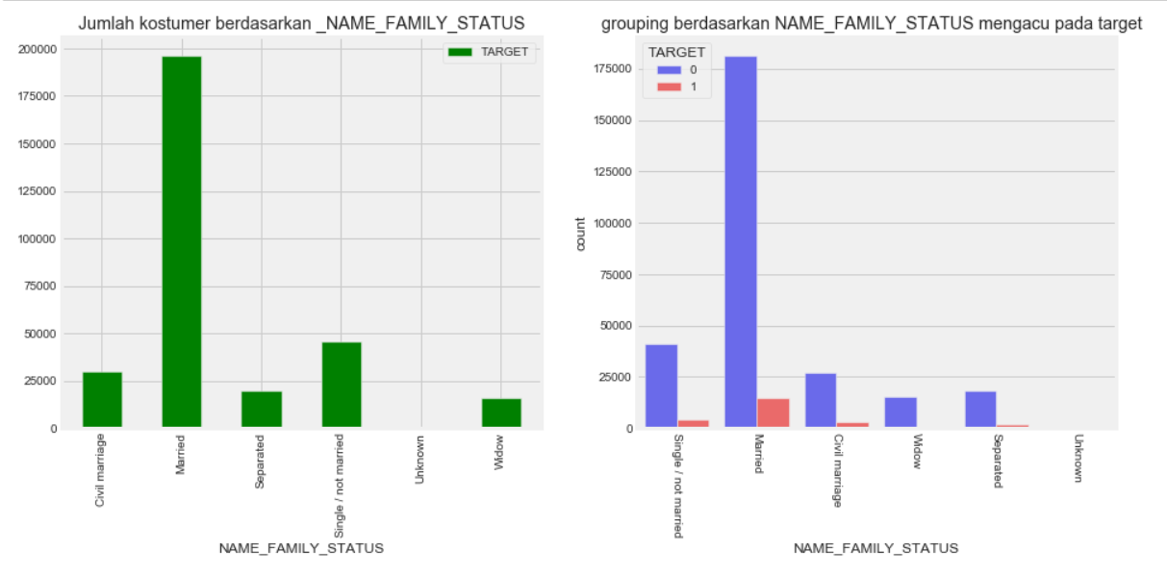
The most applicant is from married group with the most difficulties on paying back the loan

Slide 17
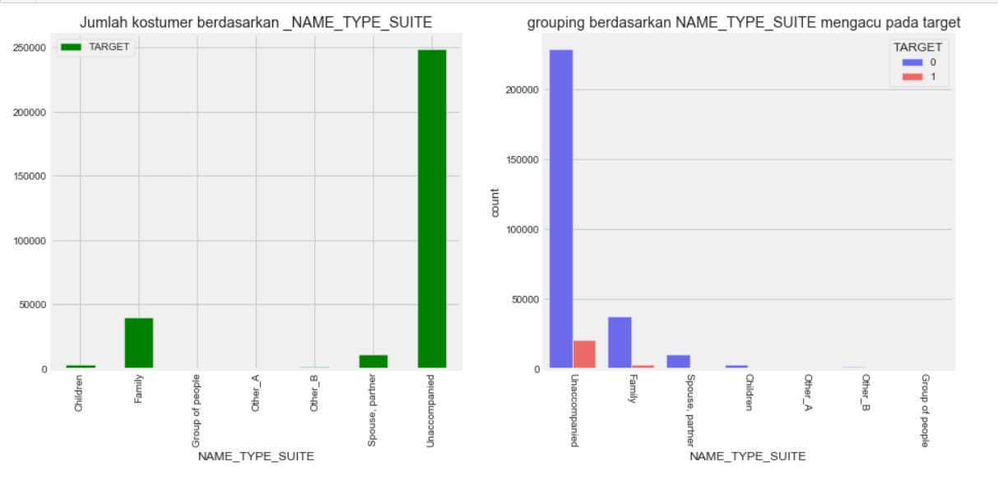
Most applicant is unaccompanied when requesting the loan and the scond highest is with his family. It is shown that the unaccompanied
Group has the most difficulties on paying back the loan

Slide 18
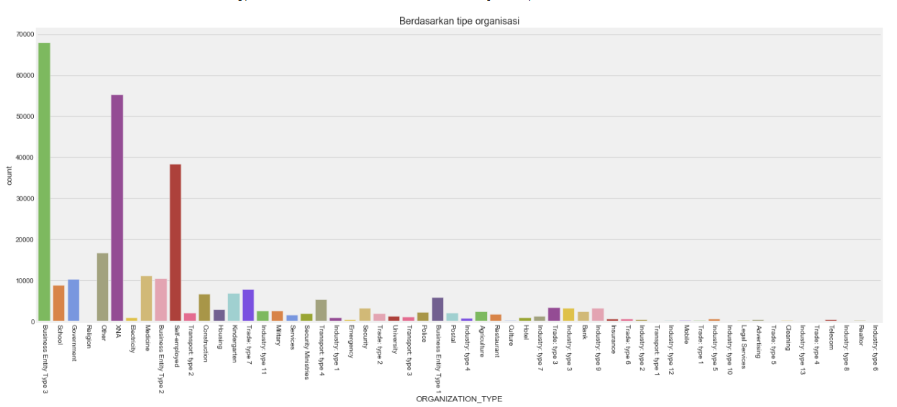
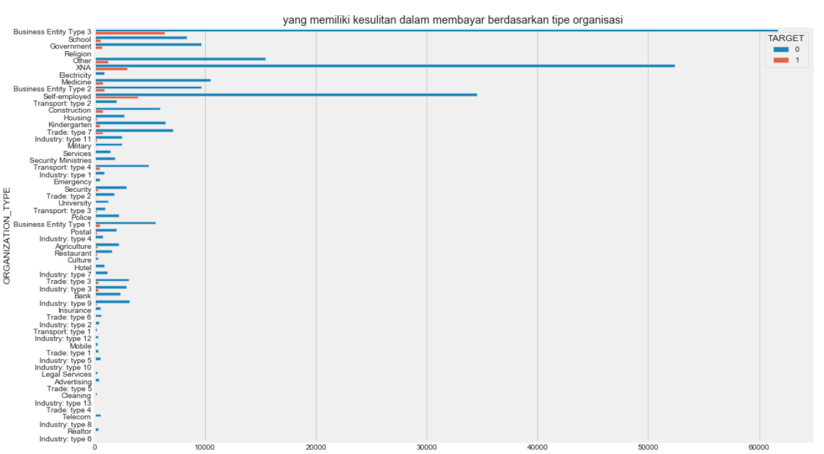
Business entity type 3 has the highest grade as loaner. And also has the most difficulties . The second highest is from businessman group

Slide 19
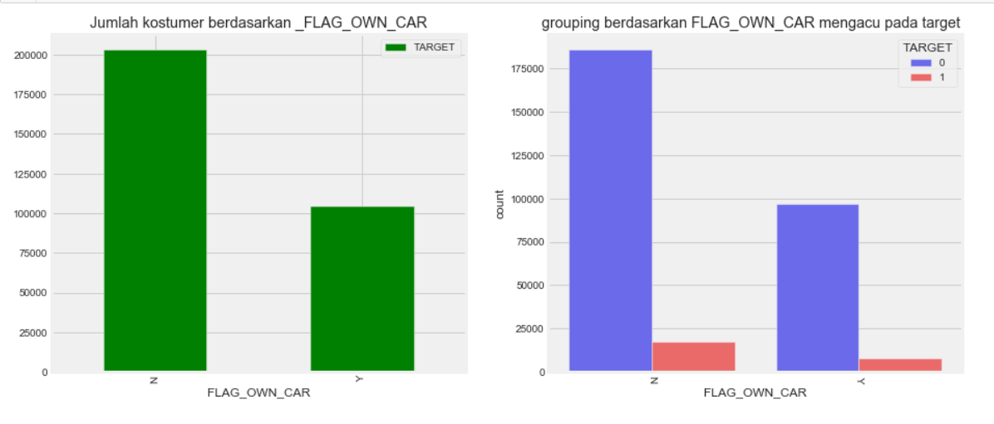
Those who own car has the least difficulties from those who don’t on paying back the laon

Slide 20
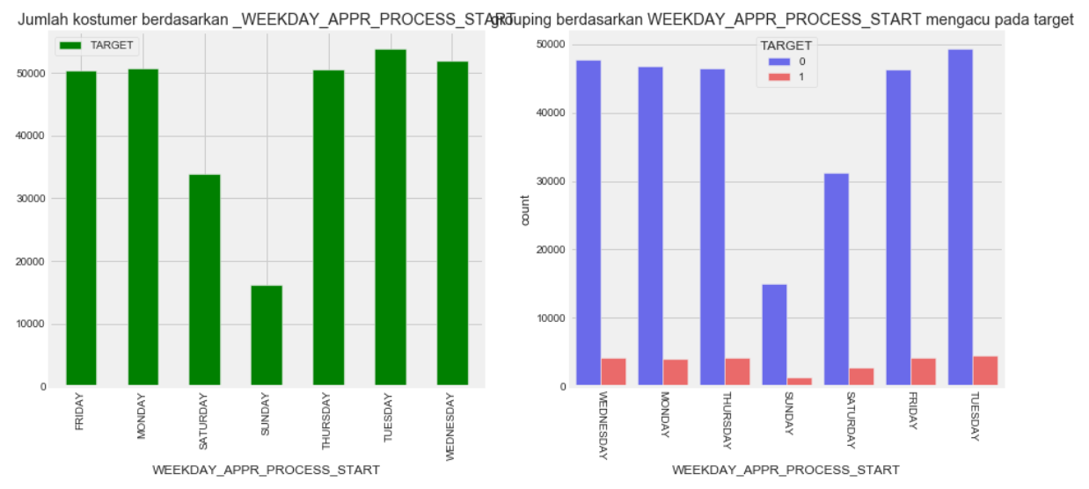
Most applicant proceed on Tuesday and it is rarely happened on Saturday/sunday

Slide 21
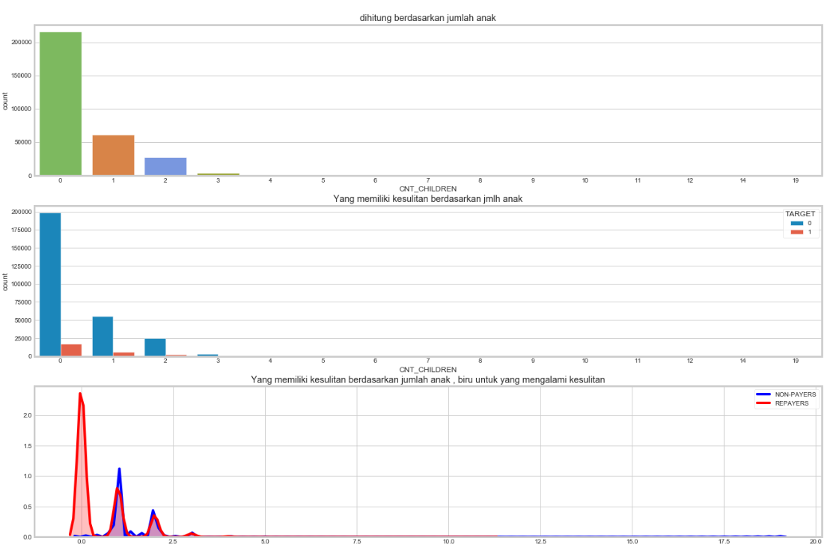
Most applicant has 0 childrend with second highest with 1 children. On distribution ratio rate the one with 1 children has the highest rate

Slide 22
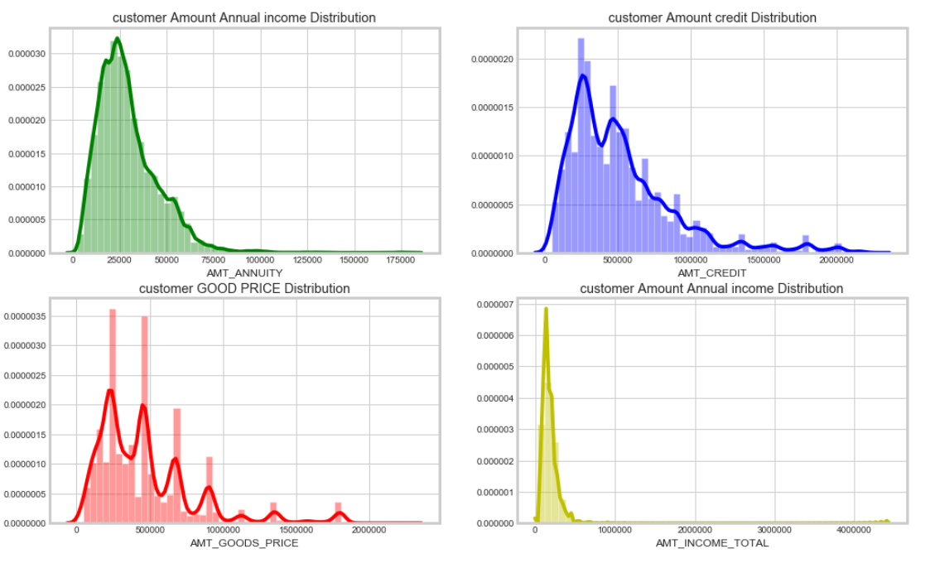
Above graph showing the data distribution
Green graph showing annual income distribution of applicant which mostly around 25k range
Red graph showing good price distribution which varied up to 2 million
Blue graph showing the amount of credit distribution given with mostly normaly distributed in 25k range
yellow graph showing the total income of applicant which is less than 1 million mostly

Slide 23
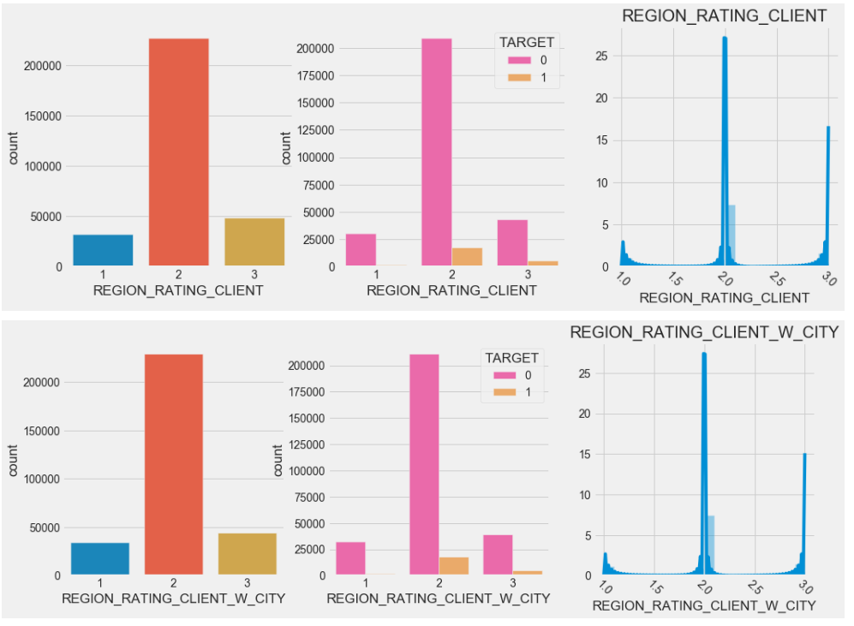
Distribution of the applicant based on region . On this graph showing the most applicant is from region 2 with the most difficulties on region 2

Slide 24
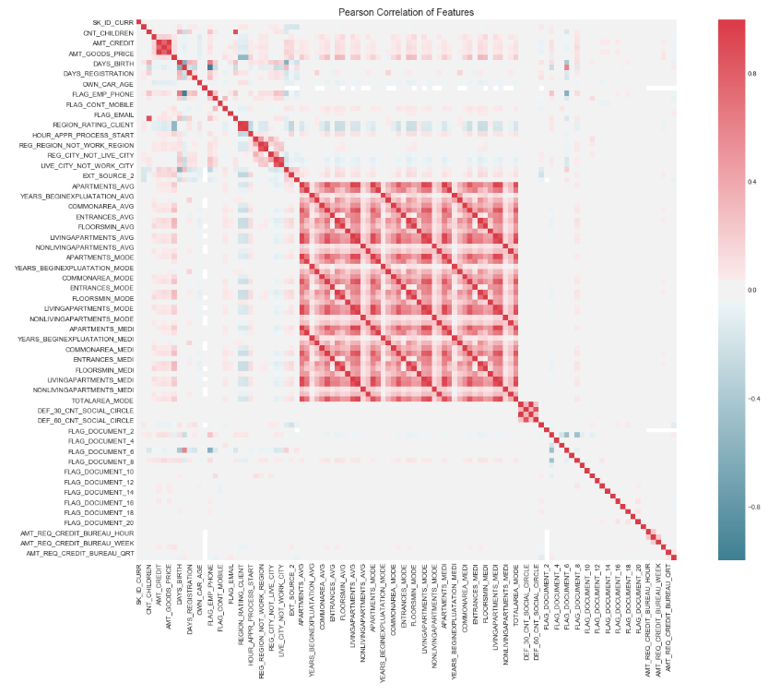
The heatmap that showing high correlated feature is around AVG feature

Slide 25
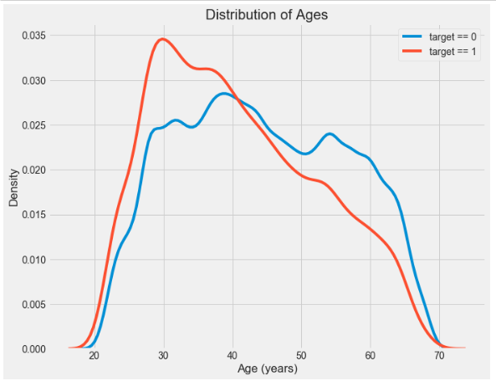
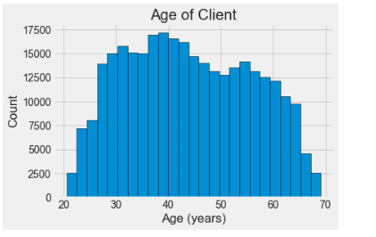
The distribution of applicant age . Its distributed from 30 to 60 Years old . The right graph showing that at around 30 Years of age has the most difficulties of paying back the loan

Slide 26
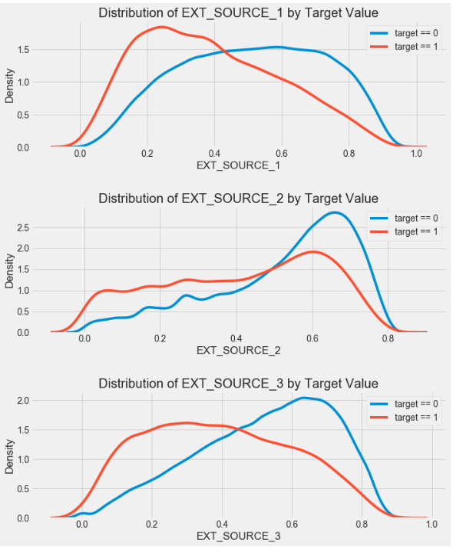
Source distribution of applicant . Divided into 3 parts based on EXT_SOURCE .Based on this we can conclude that in range 0 to 0.4 has difficulties from paying back the loan

Slide 27
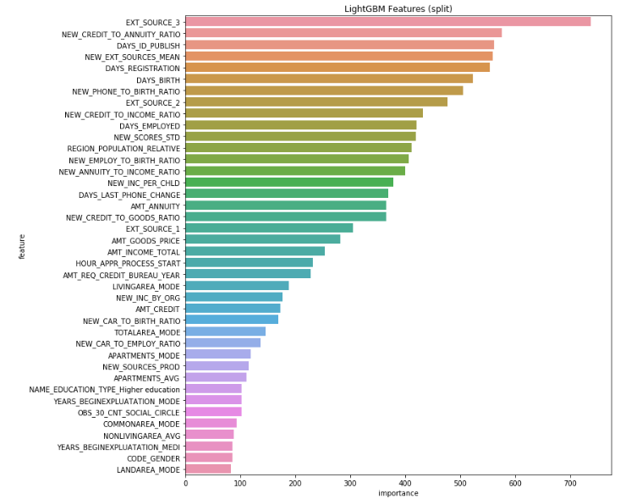
2nd part Feature Performance using LGBM
A benefit of using ensembles of decision tree methods like gradient boosting is that they can automatically provide estimates of feature importance from a trained predictive model. importance provides a score that indicates how useful or valuable each feature was in the construction of the boosted decision trees within the model
This importance is calculated explicitly for each attribute in the dataset, allowing attributes to be ranked and compared to each other.

Slide 28
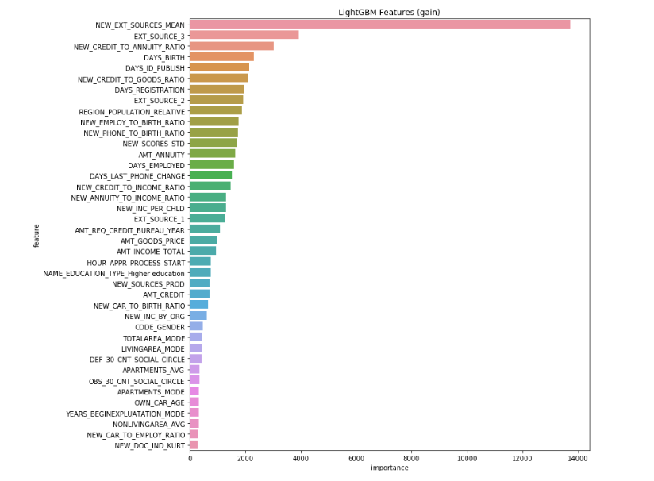
information gain . Which attribute in a given set is most useful for discriminating between the classes to be learned
Information gain tells us how important a given attribute of the feature vectors is.
Extra source is the normilized score of external data source
Information Gain = entropy(parent) – [average entropy(children)]

Slide 29
A feature is “important” if shuffling its values increases the model error, because in this case the model relied on the feature for the prediction
A feature is “unimportant” if shuffling its values leaves the model error unchanged

Slide 30
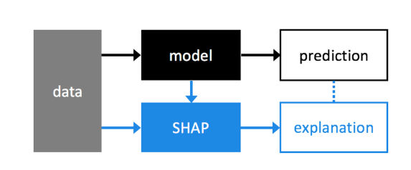
Model explanation
To explain in much more detail im gonna use SHAP. SHAP (SHapley Additive exPlanations) is a unified approach to explain the output of any machine learning model. SHAP connects game theory with local explanations .These graph would explain about the risk of credit

Slide 31
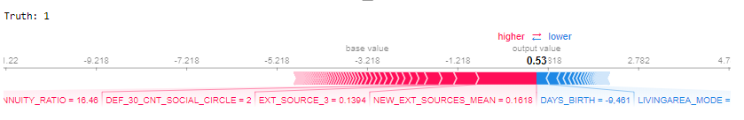
The above explanation shows features each contributing to push the model output from the base value (the average model output over the training dataset we passed) to the model output. Features pushing the prediction higher are shown in red, those pushing the prediction lower are in blue
The above example I took from customer 1 . The Red one is pushing through the blue one, means this costumer is on high risk for giving the loan since the variable like NEW_EXT_SOURCES_MEAN , EXT_SOURCE 3 etc is low . Even his DAYS_BIRTH is high

Slide 32
The above explanation shows features each contributing to push the model output from the base value (the average model output over the training dataset we passed) to the model output. Features pushing the prediction higher are shown in red, those pushing the prediction lower are in blue
The above example I took from customer 1 . The Red one is pushing through the blue one, means this costumer is on high risk for giving the loan since the variable like NEW_EXT_SOURCES_MEAN , EXT_SOURCE 3 etc is low . Even his DAYS_BIRTH is high
So basically, even if his age is okay, and he living in good area. Your NEW EXT SOURCE MEAN is too low

Slide 33
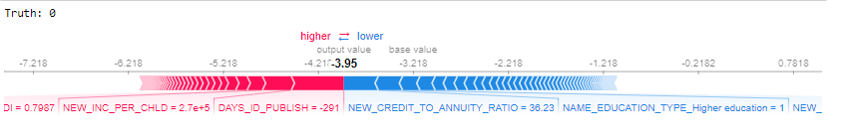
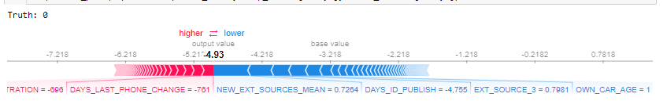
We go to costumer 2 , which has NEW_CREDIT TO ANUITY RATIO ,NAME EDUCATION TYPE high and create an insight that this customer is safe enough to loan risk
Last example we go to costumer 1000 . Which has NEW_EXT_SOURCE_MEAN, DAYS ID PUBLISH score high to give an insight that this customer is safe for loan risk

Slide 34
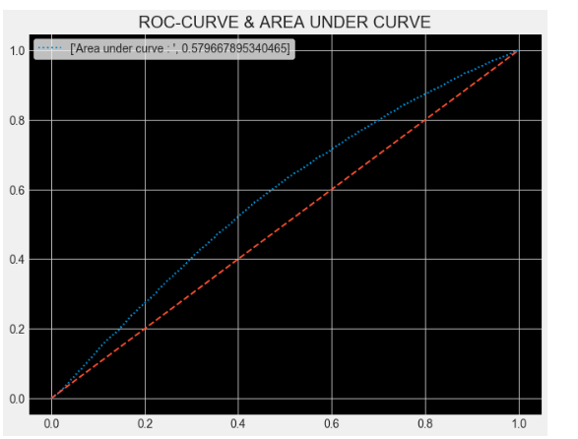
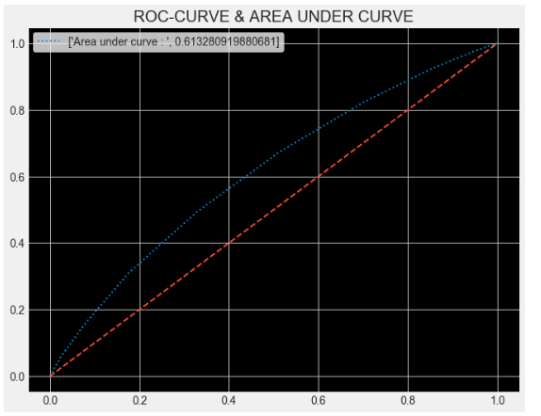
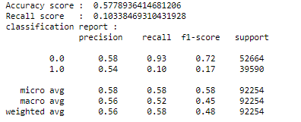
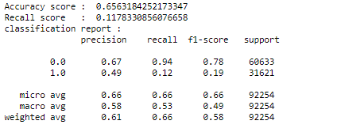
3rd part MACHINE LEARNING MODELING
Logistic
Regression
Randomforest
classifier

Slide 35
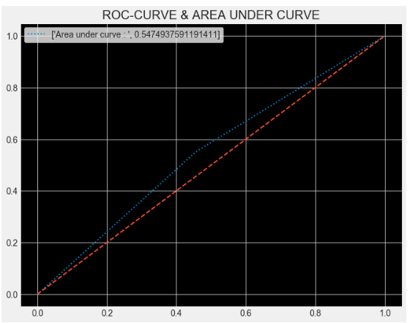
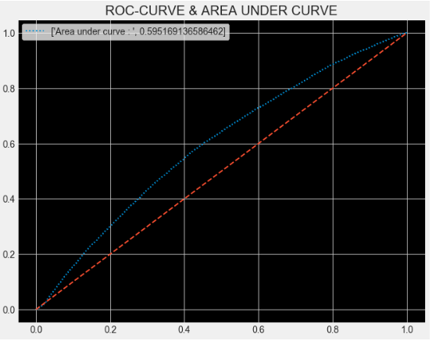
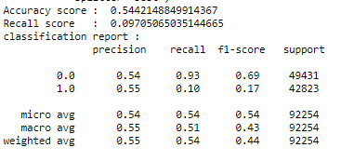
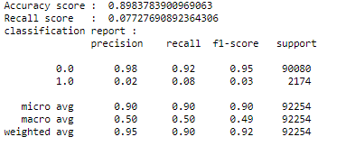
Decision
Tree
Gaussian

Slide 36
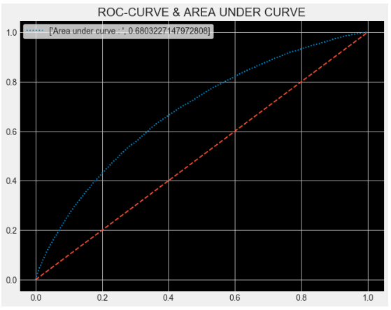
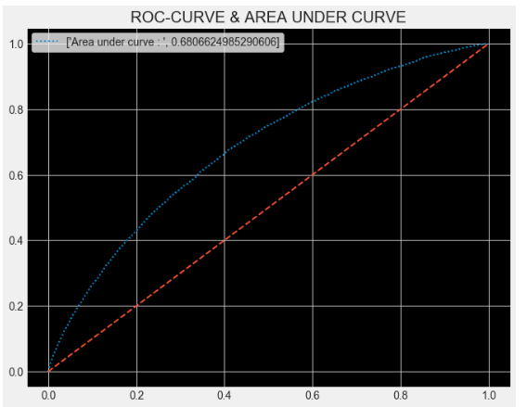
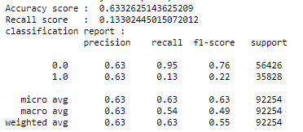
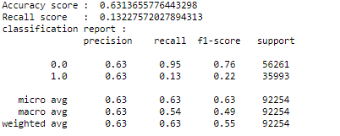
XGBOOST
Gradient Boosting

Slide 37
explanation
so back again it depends on what we wanna know?
1. Accuracy will answer this question : How many costumer did we correctly label(as target 1 or 0 ) out of all costumer
In gaussian the accuracy is 89% means . That out of 10 that we correctly predict , 1 is wrong
2. Precision will answer this question : How many of those we labeled as target 1 are actually target 1
3. Recall will answer this question : What proportion of actual positives was identified correctly
4. f1 score : is the harmonic mean precission and recall
Suggestion : in credit we want the method to be able to predict which one will paying back the loan or not . If we choose recall means the idea of false positives is far better than false negatives in this case we will get some false alarm of choosing it will make the target 0 become target 1 and get rejected.
Choose precision if you want to be more confident of your true positives. In this case gaussian has the big score
So in this case the best model to fit is gaussian method with higher accuracy and precission

